Slide 1
The Rise of the Machines
by Peter DeMartini

Slide 2
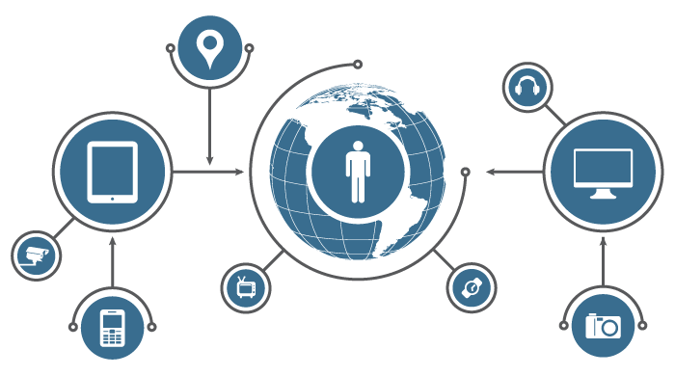
What is the
Internet of Things?

Slide 3
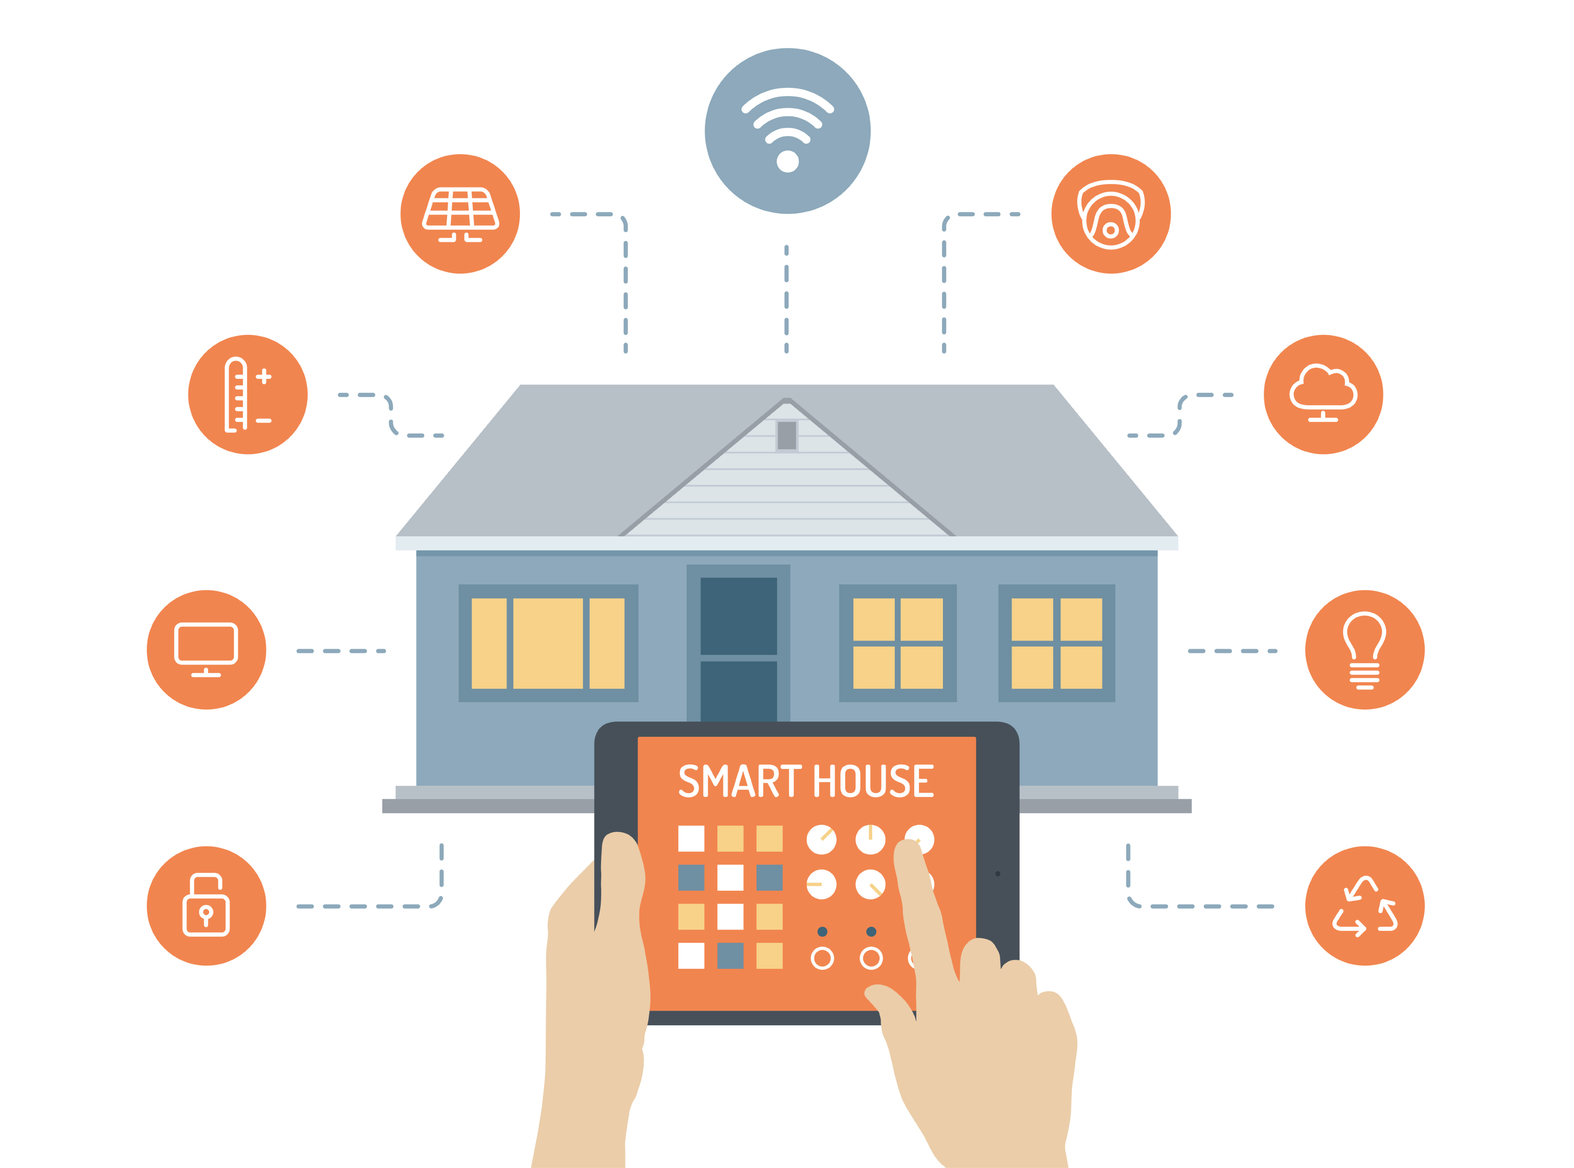
Smart Devices, Connected to Everything

Slide 4
“The Internet of Things has the potential to change the world, just as the internet did. Maybe even more so.”
~ Kevin Ashton

Slide 5
Today: 1.9B connected devices. 50B estimated by 2020. (only 5 years away)

Slide 6
By 2020, the IoT market value is predicted to be between $3T and $14T

Slide 7
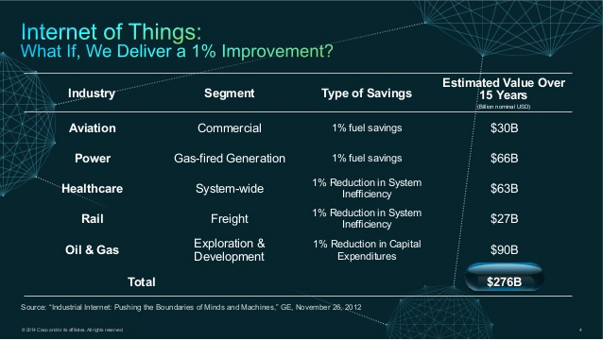

Slide 8
IoT & Business Automation

Slide 9
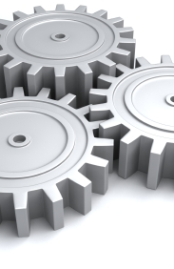
Automation
Let machines do the hardwork

Slide 10
“Everything that can be automated, will be automated.”
~ Robert Cannon

Slide 11
Machine Learning
Anomaly detection
Event prediction
Context aware systems

Slide 12
Human Interaction
Humans have the power of personality and creativity, automate the rest.

Slide 13
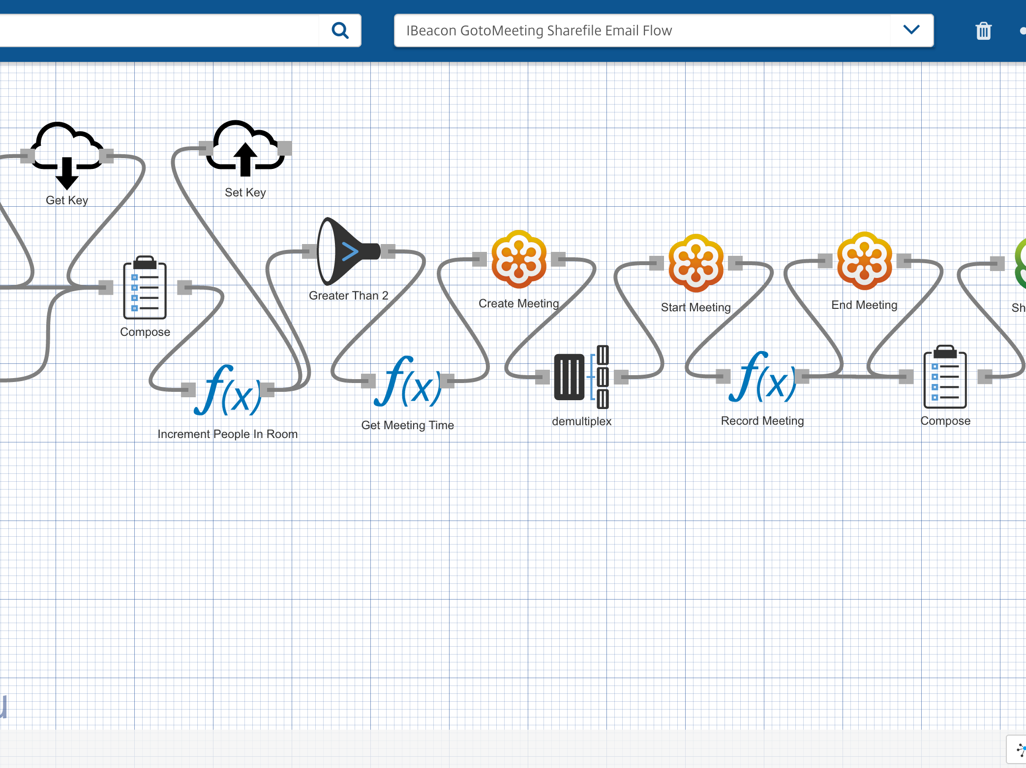

Octoblu
The Internet of Things operating system

Slide 14
Connect, Design, Compute, and Analyze

Slide 15
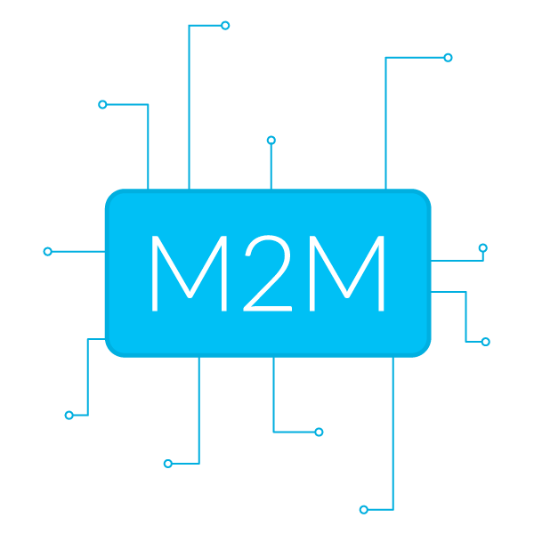
Talking to devices is hard, we make it easy

Slide 16
How we are solving the problem

Slide 17
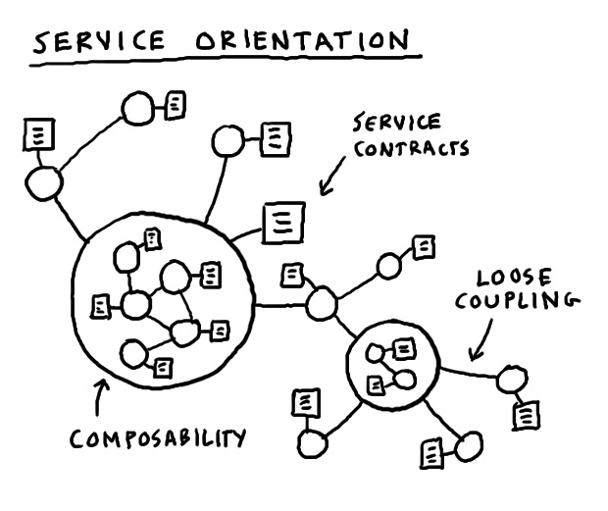
Microservices
Complex applications written in small independent programs

Slide 18
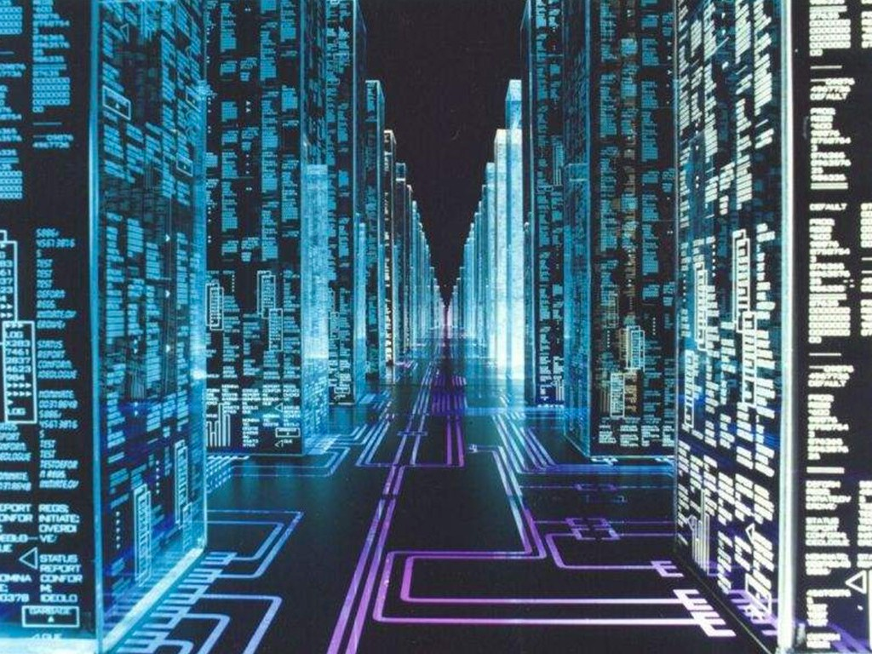
Make it easy for machines to talk to machines

Slide 19
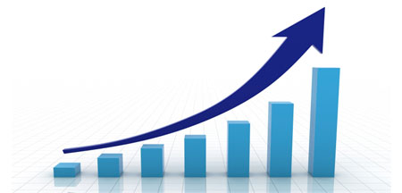
Scalability

Slide 20
With the rise of machines how do humans communicate?

Slide 21


Slide 22
A collection of services designed to engage human interactions.

Slide 23
Impact
Save man hours
Security
The power of IoT
Smart devices, smart people

Slide 24
Lessons Learned

Slide 25
Be Lazy

Slide 26
Machines cost far less than humans

Slide 27
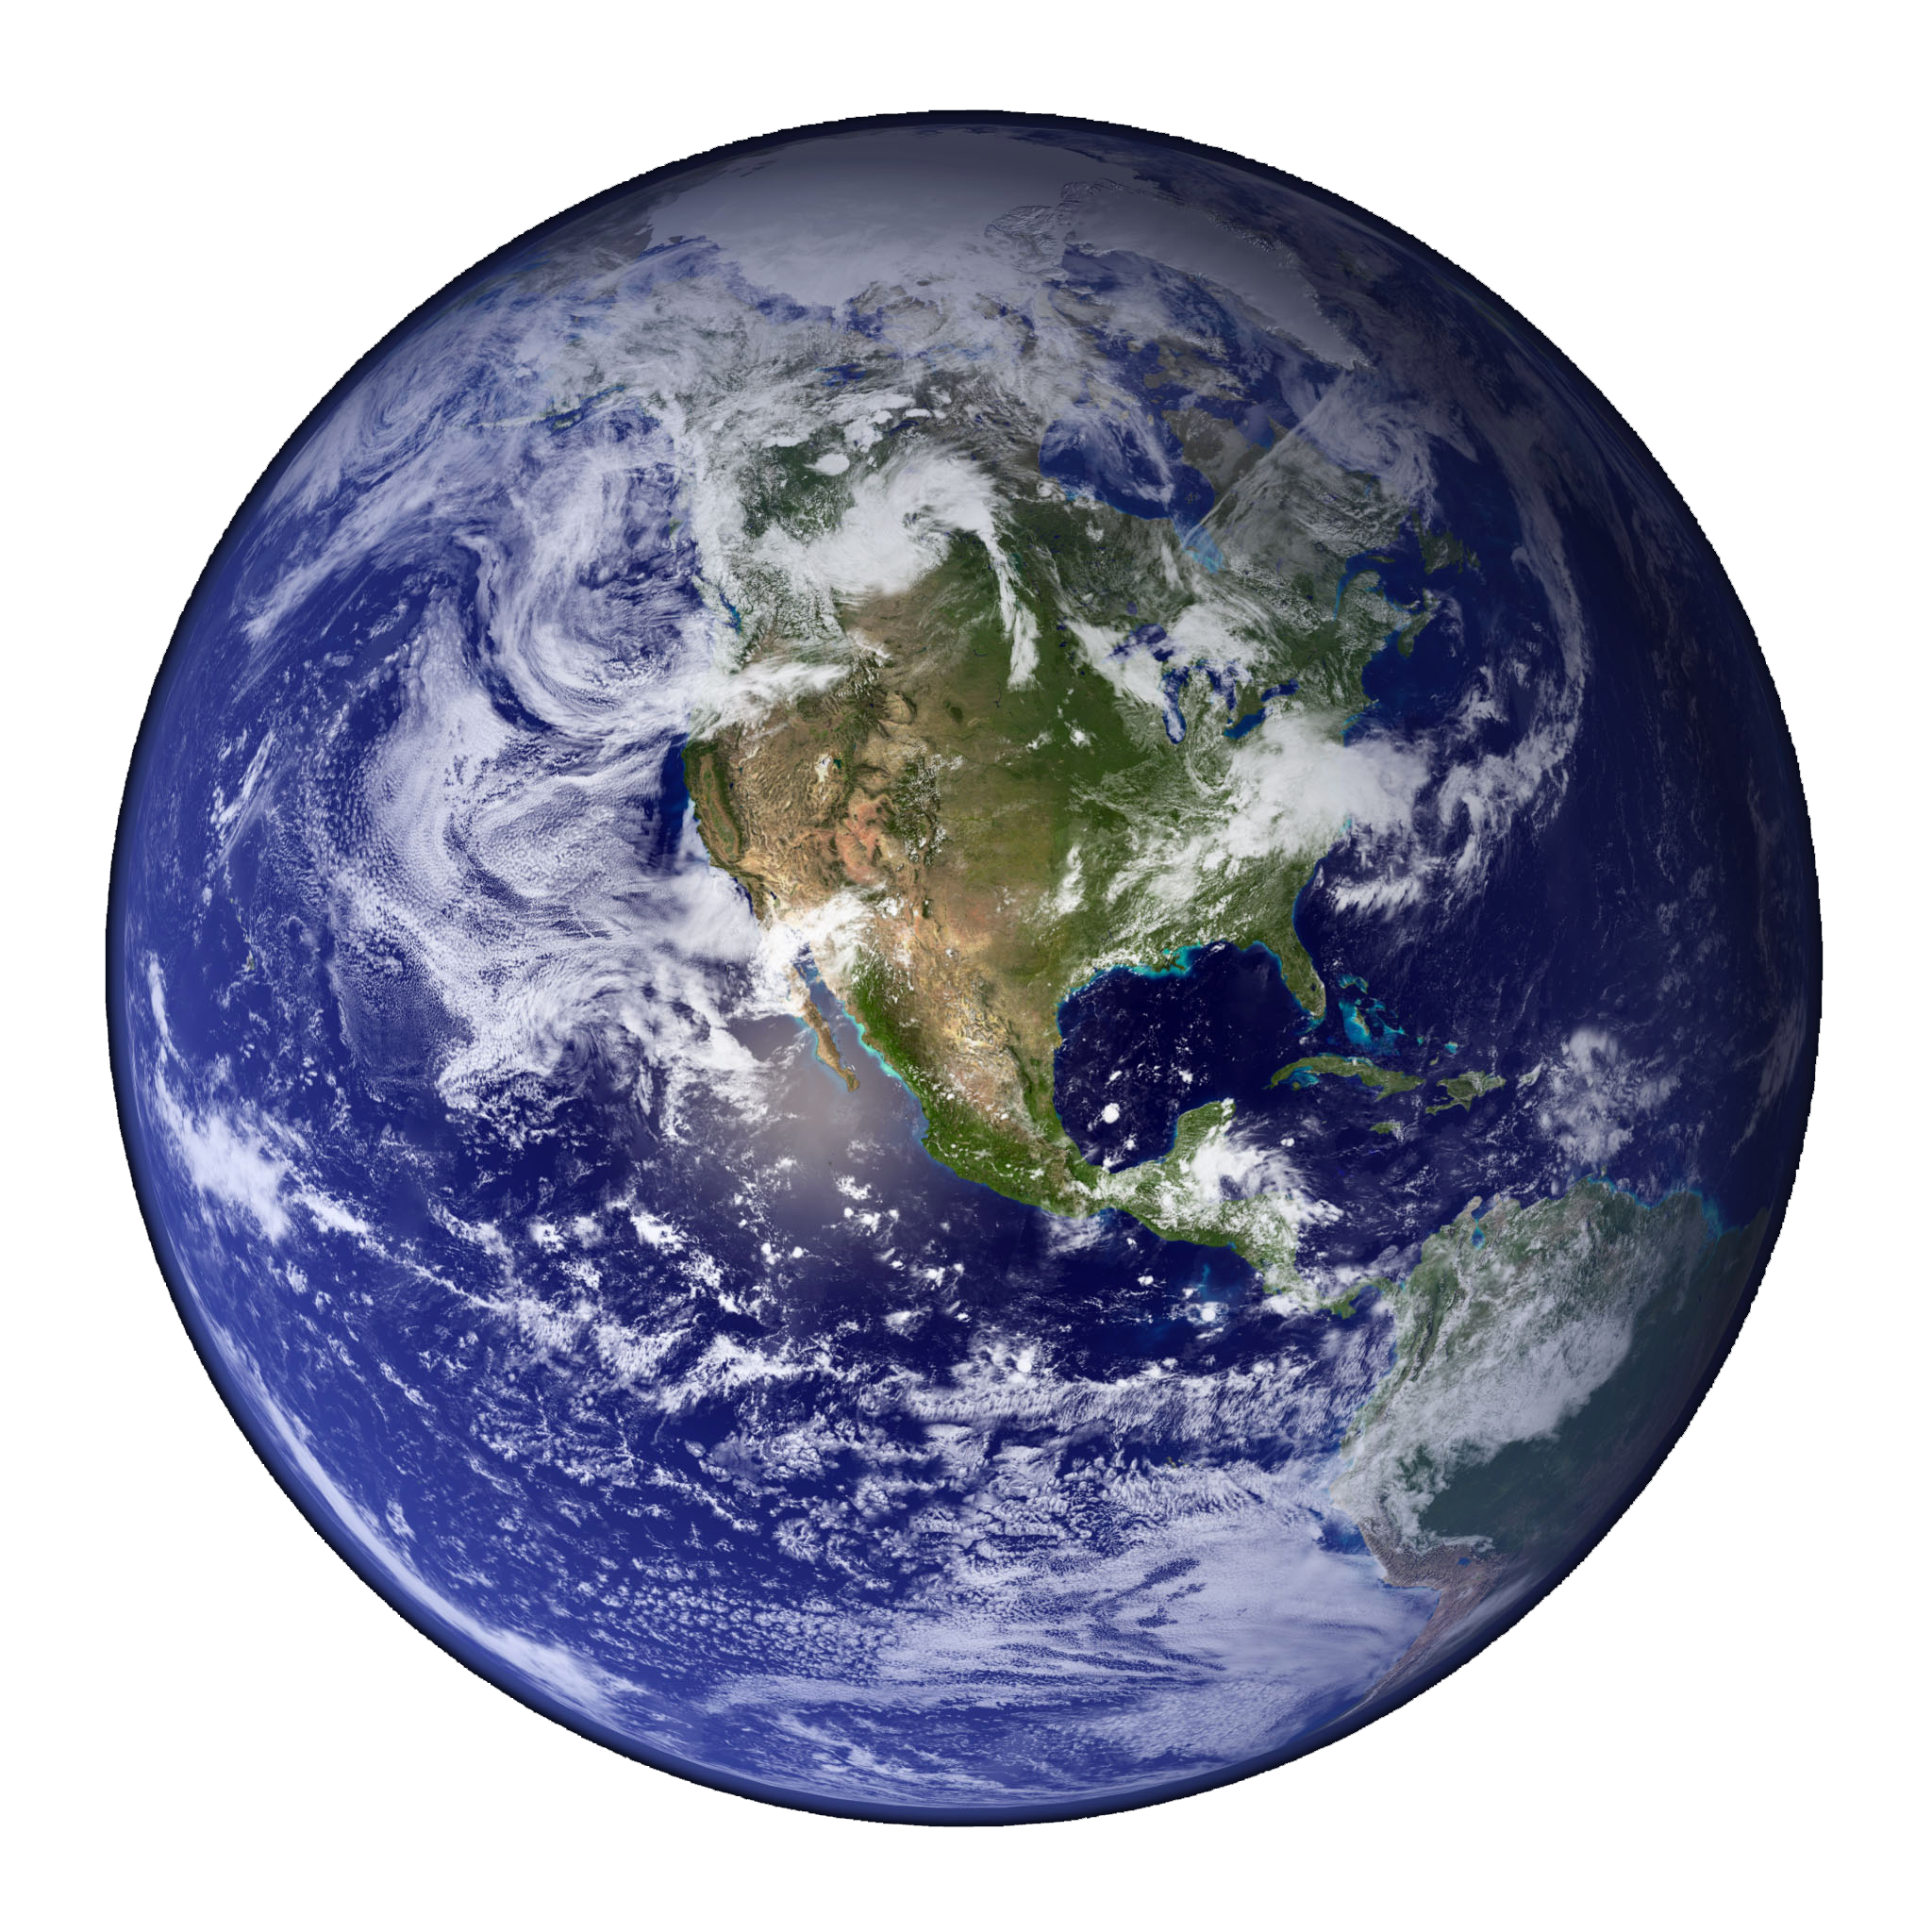
Make the world a better place

Slide 28

Let humans do what they do best

